Slide 1

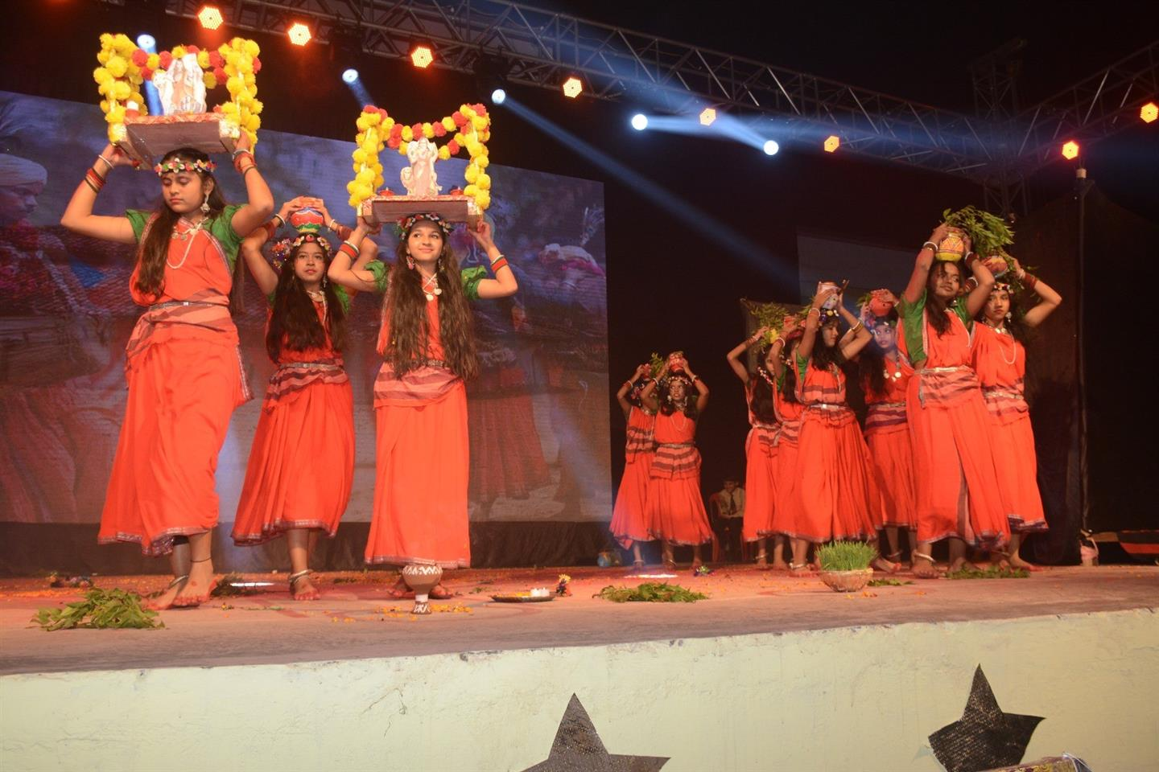
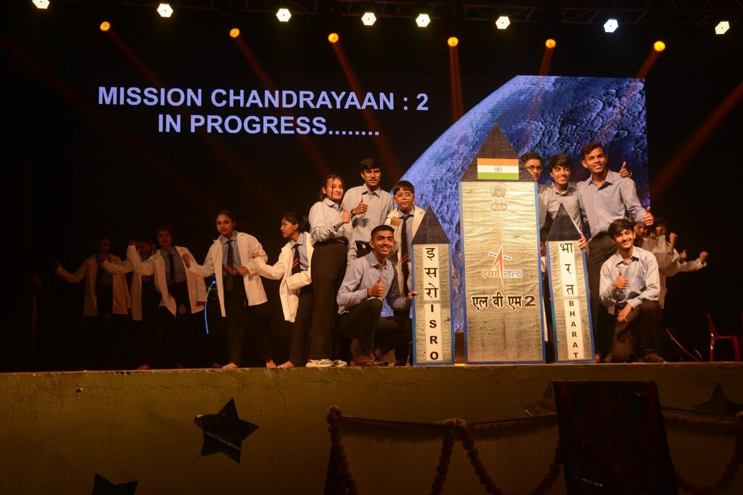
ACADEMY
MILE STONE
WELCOMES YOU

Slide 2



Achievements
SPORTS ACHIEVEMENT
1st
2nd
1
3rd
2
3

Slide 3

ACADEMICS

Slide 4



CLASS - 9A
Science Olympiad
Dron Aditya
Sahu
Reetik Raj
Prathmesh

Slide 5
CLASS - 6A
Science Olympiad
Naman
Gajendra
Jainam

Slide 6

THANK YOU
For giving your valuable time
towards our presentation

